Slide 1
OpenChain Monthly Meeting
2023-06-20

Slide 2
Anti-Trust Policy Notice
Linux Foundation meetings involve participation by industry competitors, and it is the intention of the Linux Foundation to conduct all of its activities in accordance with applicable antitrust and competition laws. It is therefore extremely important that attendees adhere to meeting agendas, and be aware of, and not participate in, any activities that are prohibited under applicable US state, federal or foreign antitrust and competition laws.
Examples of types of actions that are prohibited at Linux Foundation meetings and in connection with Linux Foundation activities are described in the Linux Foundation Antitrust Policy available at http://www.linuxfoundation.org/antitrust-policy. If you have questions about these matters, please contact your company counsel, or if you are a member of the Linux Foundation, feel free to contact Andrew Updegrove of the firm of Gesmer Updegrove LLP, which provides legal counsel to the Linux Foundation.

Slide 3
Regular Agenda
News
Work on standards and core material
Any other business
Close of meeting

Slide 4
News

Slide 5
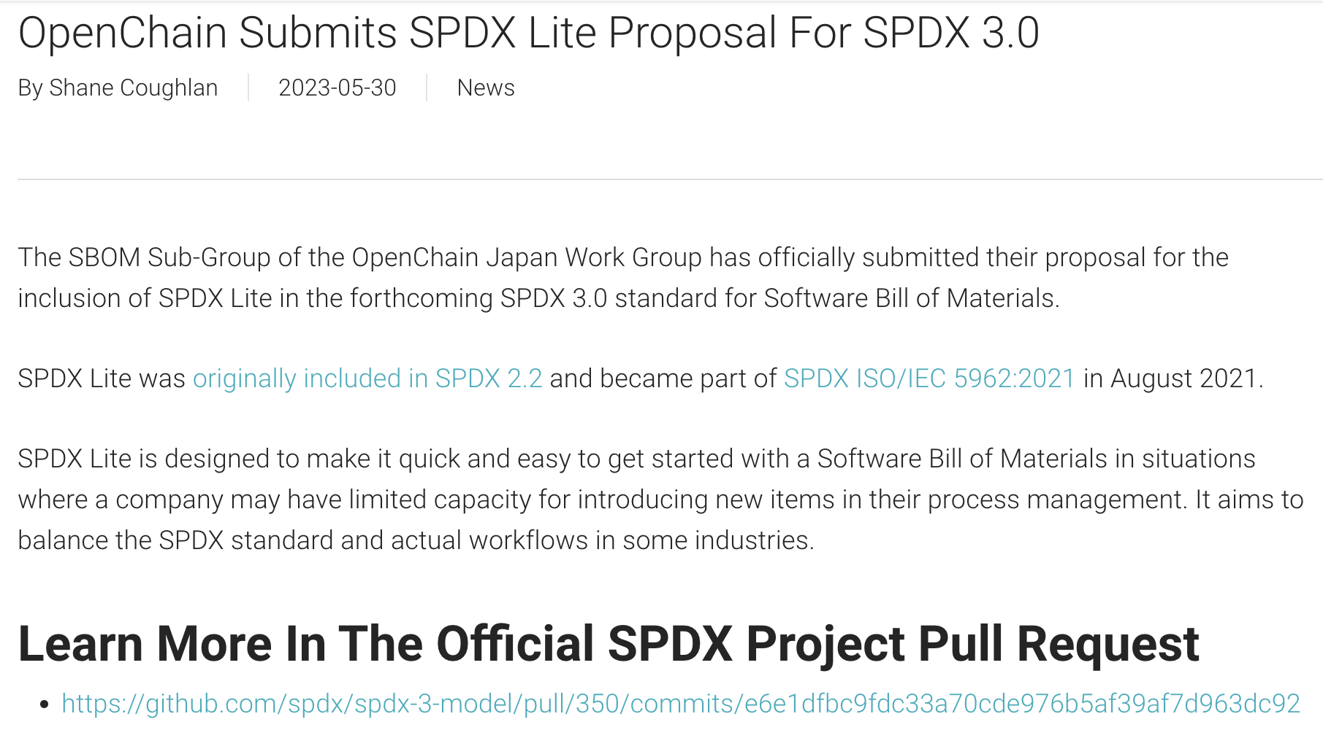
https://www.openchainproject.org/news/2023/05/30/spdx-lite-for-spdx-3-0

Slide 6

https://www.openchainproject.org/featured/2023/05/25/china-roadshow-openchain-open-source-governance-conference-2023-06-03

Slide 7

https://www.openchainproject.org/news/2023/05/24/ocs-2023

Slide 8

https://www.openchainproject.org/news/2023/05/17/reuse-software-specification-3-0

Slide 9
Work on standards and core material

Slide 10
What We Covered Last Call
Licensing Specification:
Improved Terms and Definitions as per OpenChain Monthly North America and Europe Call - 2023-06-06:
Added some words on our side: https://github.com/OpenChain-Project/License-Compliance-Specification/commit/78ba24492cdcfaf65a32c3de9f95044dabdafa9c
Updated Terms and Definitions with key words as per https://www.ietf.org/rfc/rfc2119.txt: https://github.com/OpenChain-Project/License-Compliance-Specification/issues/67
Changed SPDX definition to Software Bill of Materials definition citing SPDX as per OpenChain Monthly North America and Europe Call - 2023-06-06 and #35:
https://github.com/OpenChain-Project/License-Compliance-Specification/issues/35
.com/OpenChain-Project/License-Compliance-Specification/issues/35

Slide 11
What Is Scheduled For Today
Security Specification:
Align Terms and Definitions with Licensing Spec 3.0 https://github.com/OpenChain-Project/Security-Assurance-Specification/issues/30
Align Software Bill of Materials with Licensing Spec 3.0 https://github.com/OpenChain-Project/Security-Assurance-Specification/issues/31
Check the next two slides for the current and future draft standards

Slide 12
Current Published Versions of the Standards
Licensing Specification (CURRENT VERSION, 2nd Generation):
https://github.com/OpenChain-Project/License-Compliance-Specification/blob/master/2.1/en/openchainspec-2.1.md
Security Specification (CURRENT VERSION, 1st Generation):
https://github.com/OpenChain-Project/Security-Assurance-Specification/blob/main/Security-Assurance-Specification/1.1/en/openchain-security-specification-1.1.md
These are the current published versions of the standards The drafts we are editing are on the next slide

Slide 13
Draft Future Versions of the Standards
Licensing Specification (3rd Generation Draft):
https://github.com/OpenChain-Project/License-Compliance-Specification/blob/master/Official/en/3.0/openchain-license-compliance-3.0.md
Security Specification (2nd Generation Draft):
https://github.com/OpenChain-Project/Security-Assurance-Specification/blob/main/Security-Assurance-Specification/2.0/en/openchain-security-specification-2.0.md
Here are the drafts we are editing

Slide 14
Any other business

Slide 15
Close of meeting

Slide 16
See you next time!

